Slide 1

PROJECT WORK PHASE Ⅰ
PRESENTATION
How Data-Driven Entrepreneur Analyzes Imperfect Information for Business Opportunity Evaluation
Presented by
AKASH SUMAN DAS(4MU16CS001)
CALVIN ABRAHAM(4MU16CS015)
GURU PRASAD S(4MU16CS020)
RAAKSHITH(4MU16CS090)
Under the Guidance of
SOUMYA BJ
(Project Mentor)
HARISH BORAIAH (Project Guide)
Dept. of Computer Science & Engg.
MYSURU ROYAL INSTITUTE OF TECHNOLOGY
Lakshmipura Road, Palahally Post, Off Mysuru-Bengaluru Highway,
SR Patna, Mandya – 571606

Slide 2

INDEX:
Abstract
Introduction
Objective
Literature Survey
Existing System
Disadvantages
Feasibility Study
Markov Model
Proposed System
Advantages
Architecture
Software and Hardware requirements
System Design and Implementation
Modules Included
Conclusion
References

Slide 3
ABSTRACT:
High market uncertainty impedes an Entrepreneur’s ability to evaluate the state of the market for a business opportunity .
Data collection and analysis techniques and technologies are becoming an important source to manage uncertainty, This often refers to Data driven Entrepreneurship.
In this project we consider a dynamic approach using data to overcome market uncertainty.
By developing a model that analyse imperfect market data an Entrepreneur can easily evaluate imperfection in Business analysis.

Slide 4
INTRODUCTION:
Primary focus of entrepreneurship research .
Infusion of data analysis and techniques, technology in entrepreneurship will generate a new way of dealing with uncertainty.
A growing number of venture capitalists have employed automated data analysis techniques to evaluate business investments.
Data driven techniques and technologies improves shaping activities of the entrepreneurial process.

Slide 5
OBJECTIVE:
Understanding the nature and source of uncertainty.
Operational storage of 4Rs- on overcoming market uncertainty.
Data driven perspective of entrepreneurship.
Data driven entrepreneurship demands .
Analysing real time and imperfect data in order to make an optimal portfolio of investments.

Slide 6
Literature survey:
Opportunity evaluation is the core of entrepreneurial decision making .
McKelvey et al found that an increase in uncertainty decreases the entrepreneur’s willingness to act on an opportunity in the face of uncertain environmental conditions.
Developing strategies to hedge adverse outcome.
Developing operational storage.
Implementation of data driven technologies.
Specifying mathematical track table risk choice problem .

Slide 7
EXISTING SYSTEM:
Consider an entrepreneur who is evaluating a business opportunity for a market in a multi period setting.
The state of market whether the market has a positive or negative outlook for the entrepreneur’s opportunity depends on variety of factors
The entrepreneur’s risk preference and operational shortages influence the entrepreneur’s ability to observe the state of the market and take control over market changes.
To exemplify the impact of an external factor on opportunity assessment, we offer a simulated example of an entrepreneurial venture in a developing industry (e.g., clean energy).

Slide 8
Although the new venture’s investors may provide some policy and regulatory assistance, the regulations for an emerging technology may be transient, which is likely to result in a hidden market.
The entrepreneur in our model gathers information about the market by allocating her/his total funds X across a portfolio of investments in f independent external market factors over T Periods.
DISADVANTAGES: 1.More or less is probability based 2.Process is not secured for the data analyzing system

Slide 9
FEASIBILITY STUDY:
Feasibility study contributes to the operational and data-driven perspectives of entrepreneurship by refining decision making using a data-driven technique for the opportunity evaluation in a dynamic entrepreneurial process
Furthermore we contribute to entrepreneurial decision making under uncertainty by identifying the trade off between expected returns and market information.
and providing insights into how data-driven investment portfolio can be used to manage this trade off, while accounting for the entrepreneur’s risk preference and operational shortages

Slide 10
MARKOV MODEL:
A Markov model is a stochastic method for randomly changing systems where it is assumed that future states do not depend on past states. These models show all possible states as well as the transitions, rate of transitions and probabilities between them.
There are four types of Markov models:
1.Markov chain - used by systems that are autonomous and have fully observable states 2.Hidden Markov model - used by systems that are autonomous where the state is partially observable.

Slide 11
3.Markov decision processes - used by controlled systems with a fully observable state. 4.Partially observable Markov decision processes - used by controlled systems where the state is partially observable.
Markov models can be expressed in equations or in graphical models. Graphic Markov models typically use circles (each containing states) and directional arrows to indicate possible transitional changes between them.

Slide 12
PROPOSED SYSTEM:
Although our model has enabled us to examine a new method of evaluating a hidden market process, several assumptions, limitations, and related extensions to this research need to be acknowledged.
our key assumptions pose inherent limitations on our model. For example, although our assumption about an exogenous and independent change in the valuation of investments does not necessarily change our insights, the relaxation of this assumption could lead to more profound insights into the market.
DP (Dynamic programming) Model allows two functions they are:
Path-dependence
Non-Linearity
These Two properties are important, assuming that a Markov model is a close representation of decision-making in real-world entrepreneurial contexts.
we did not account for dependence between market factors and selection bias for market factors.

Slide 13
The Interface Between the Operational Management(OM)and Entrepreneurship involves the decision-making under the Business Opportunity.
We check the Validity of the Received Information Which raises the Question of How an Entrepreneur can make ensure that the person inputting the right information.
Thus we verify the both validation and selection process of Market factors.
Finally, it would be helpful to examine how entrepreneurs adapt to market realities while their internal processes and technologies evolve. That involve various fields such as:
Strategy.
Risk Taken.
OM (operational Management).
Entrepreneurship.
Financially Help
Money Management.

Slide 14
ADVANTAGES:
Business opportunity calculated is easily
Time is save for this process
Money is not waste in this analysis
Most secured process

Slide 15
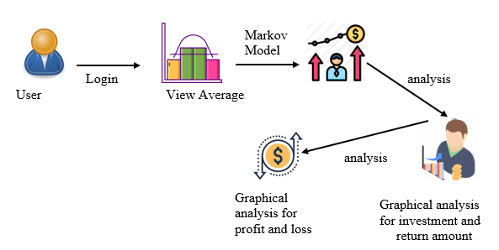
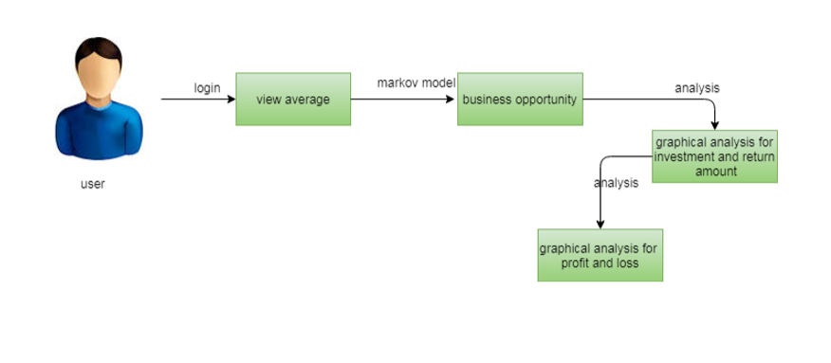
ARCHITECTURE:
Figure : Architecture of proposed model

Slide 16
Step 1:First we collect data set in different fields (generic) like Investment,Return Amount,Profit,Loss in Last 6 years
Step 2:Analysis for
Investment Average
Return Amount Average
Profit Average
Loss Average
Step 3:Markov Chain Model:
A Markov Chain Model is “ a stochastic model describing a sequence of possible events in which the probability of each event depends only on the state attained in the previous event”.
Step 4: Graphical analysis For Investment Average.
Step 5: Graphical analysis For Return Amount Average.
Step 6 : Graphical analysis For Profit Average.
Step 7 : Graphical analysis For Loss Average.

Slide 17
SOFTWARE HARDWARE REQUIREMENTS:
Software Requirements:
1. Python
2. Django
3. MySQL
4. WampServer.
Hardware Requirements:
1.Processor: Pentium IV or higher
2.RAM: 2GB
3.Space on Hard Disk: minimum 512MB

Slide 18
SYSTEM DESIGN AND IMPLEMENTATION:
Design:
Consider an entrepreneur who is evaluating a business opportunity for a market in a multiperiod setting.
The state of the market—whether the market has a positive or negative outlook for the entrepreneur’s opportunity—depends on a variety of external market factors such as economic, governmental, social, and regulatory that may not be directly observable and may change over time.
Entrepreneur’s Opportunity depends on
Economic
Governmental
Social
Regulatory

Slide 19
It also include 4Rs (i.e., internal constraints ) they are:
Refresh
Recycle
Retire
Replace.
To exemplify the impact of an external factor on opportunity assessment, we offer a simulated example of an entrepreneurial venture in a developing industry (e.g., clean energy).
The entrepreneur may not have established know-how of external market regulations and lobbying practices for the technology (i.e., shortage of external regulations).
Therefore, he or she might not be able to fully evaluate the true economic outlook positive or negative without understanding the regulatory conditions, particularly among the rapidly changing laws surrounding energy.

Slide 20
SYSTEM DESIGN AND IMPLEMENTATION
Implementation:
Base scenario:
Numerical analysis.
Focuses on two investment.
Investment 1 with NI and Investment 2 with FI
Higher expected returns with Investment 1.
The limited-funded or cash-strapped entrepreneur with low risk aversion could generate higher returns with Investment 1, reducing the proportion of Investment 2 in the portfolio

Slide 21

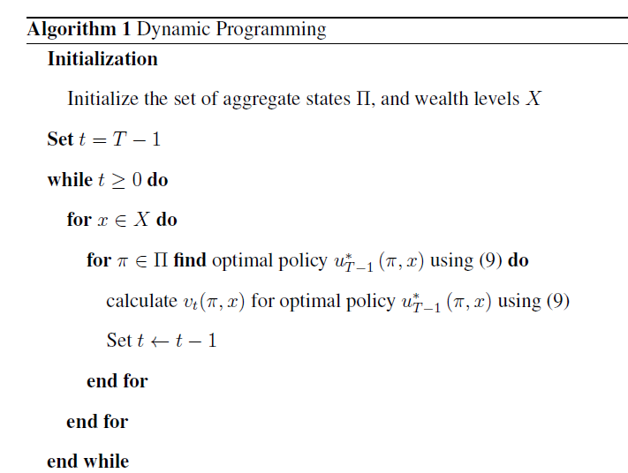
ALGORITHM:

Slide 22

Market observability:
In the base scenario, we found numerical evidence demonstrating the tradeoff between expected returns and market information.
The entrepreneur’s cash level and risk preference is focused.
This insight is also valid with a larger portfolio of four investments
(m = 4) including POMDP-infused Investments 3 and 4.

Slide 23



MODULES INCLUDED:
There are three modules can be divided here for this project they are listed as below
Agriculture
Industries
cooperate environment
From the above three modules, project is implemented. Bag of discriminative words are achieved

Slide 24
CONCLUSION:
We develop a dynamic data analysis technique based on a POMDP model to answer how to analyze imperfect market data for business opportunity evaluation.
Entrepreneur’s individual risk preference and operational shortages are analyzed.
We obtain a probabilistic information measure in the form of an emission matrix.
Our algorithm numerically mimics the POMDP-based model.
Rather than pursuing the highest expected returns, an entrepreneur may choose perfect information, risk hedging, or market controlling investments, based on his/her cash level and risk preference, in order to maximize the venture’s prospects

Slide 25
REFERENCES:
[1] F.H.Knight, Risk, Uncertainty and Profit. NewYork,NY, USA: oughton Mifflin, 1921.
[2] A. McKelvey, J. M. Haynie, and V. Gustavsson, “Unpacking the uncertainty construct: Implications for entrepreneurial action,” J. Bus. Venturing,
vol. 26, pp. 273–292, 2011.
[3] S. Nambisan, “Digital entrepreneurship: Toward a digital technology perspective of entrepreneurship,” Entrepreneurship Theory Pr act no. 6, pp. 1029–1055, 2017.

Slide 26

THANK YOU

